Slide 1

A.V.C COLLEGE OF ENGINEERING IT6811 - PROJECT WORK - VIII Semester DEPARTMENT OF INFORMATION TECHNOLOGY
Project Title :
Securing Data in Internet of Things (IoT) Using
Cryptography and Steganography Techniques
Guided by
Assistant Professor-IT

Slide 2
OBJECTIVE
Security challenges can be mitigated with cryptography and steganography techniques. These techniques are crucial when dealing with user authentication and data privacy.
In the proposed work, the elliptic Galois cryptography protocol is introduced and discussed.

Slide 3
INTRODUCTION
Internet of Things (IoT) is a domain wherein which the transfer of data is taking place every single second. The security of these data is a challenging task;
Various parameters are evaluated and compared with the existing techniques. Finally, the data that is hidden in the image is recovered and is then decrypted.

Slide 4
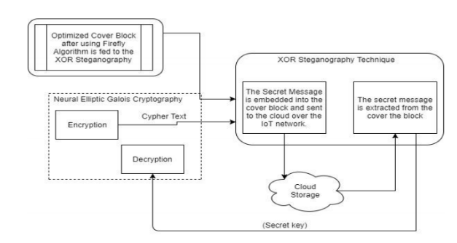
Proposed Matrix-XOR steganography technique

Slide 5
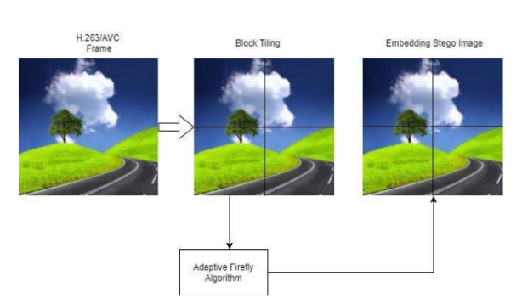
Adaptive Firefly optimization

Slide 6
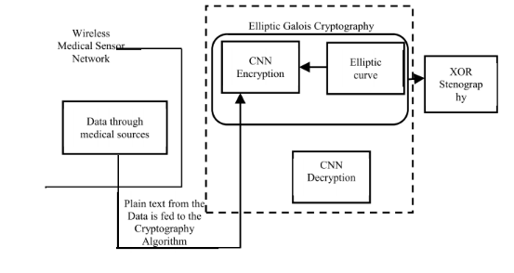
Block Diagram

Slide 7
EXISTING SYSTEM
Software virtualization and assembly level code verification to provide memory isolation and custom security.
Energy-efficient datagram transport layer security (eDTLS), which is a low-energy variant of datagram transport layer security (DTLS) that had the same security strength but a lower energy requirement.
A cloud-based anti-malware system. The proposed system provided efficient and trusted security services to the devices in the IoT network.

Slide 8
ALGORITHMS USED
Elliptic curve cryptography (ECC)
Matrix XOR steganography
Adaptive Firefly algorithm

Slide 9
REFERENCES
1. R. H. Weber, “Internet of Things—New security and privacy challenges,” Comput. Law Security Rev.,
2. A. Ukil, J. Sen, and S. Koilakonda, “Embedded security for Internet of Things,” in Proc. 2nd Nat. Conf. Emerg. Trends Appl. Comput. Sci. (NCETACS), Mar. 2011

